Slide 1
TSBK07 Project
The Quest for the Holy Grail
Loïs Bilat and Felix Eklöf
Notes:
Felix - Welcome

Slide 2
Presentation Plan
What is it ?
What was implemented ?
Gameplay Demo
Technicals details
Conclusion
Sources
Questions
Notes:
Felix - Presentation Plan
What is it ?
What was implemented ?
Gameplay Demo
Technicals details
Conclusion
Sources
Questions

Slide 3
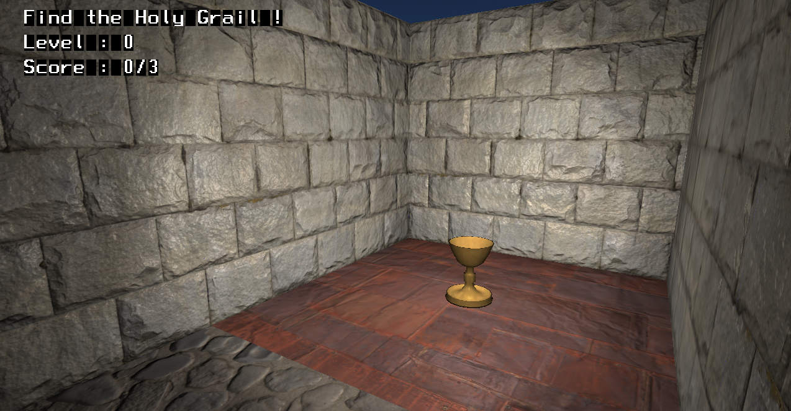
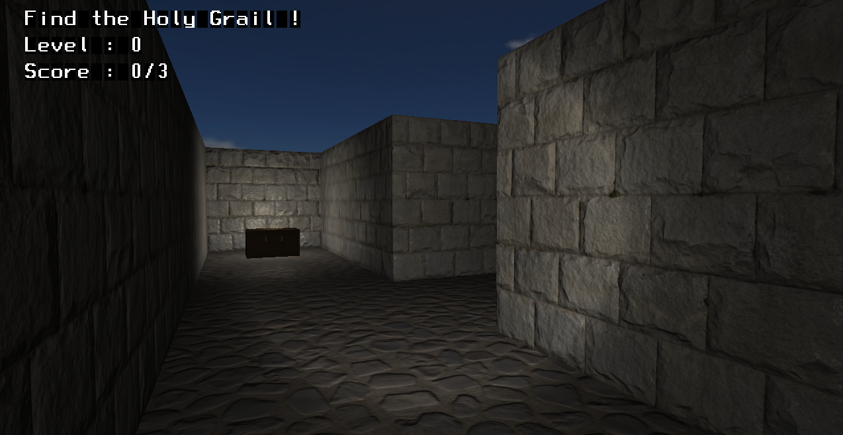
What is it ?
First person 3D Maze game
You have to find the Holy Grail and bring it back
The path to the Holy Grail is blocked by multiple doors, you have to find a way to open them
You can improve your score by finding the hidden chests.
Notes:
Felix - What is it ?
First person 3D Maze game
CLICK You have to find the Holy Grail and bring it back
The path to the Holy Grail is blocked by multiple doors, you have to find a way to open them
CLICK You can improve your score by finding the hidden chests.

Slide 4
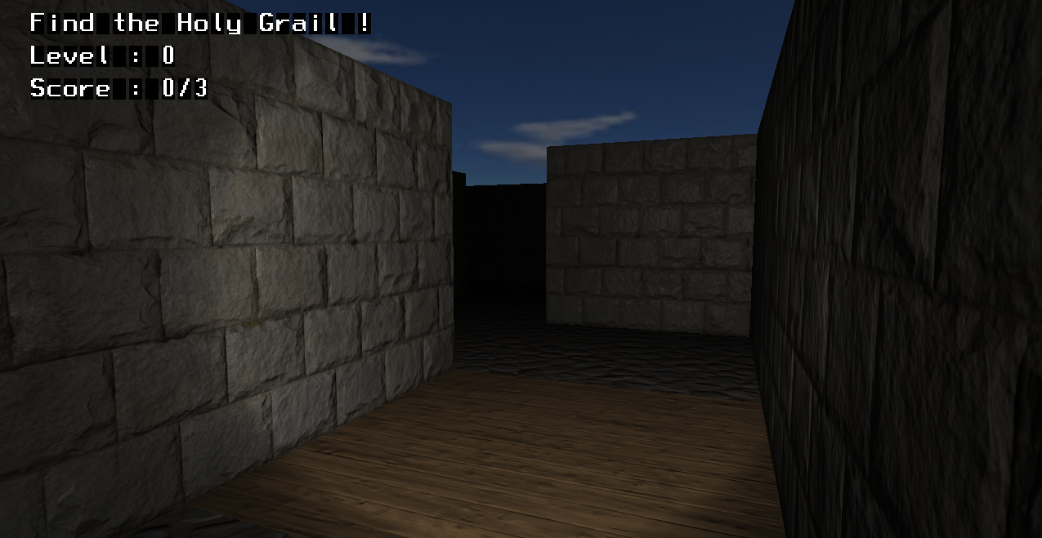
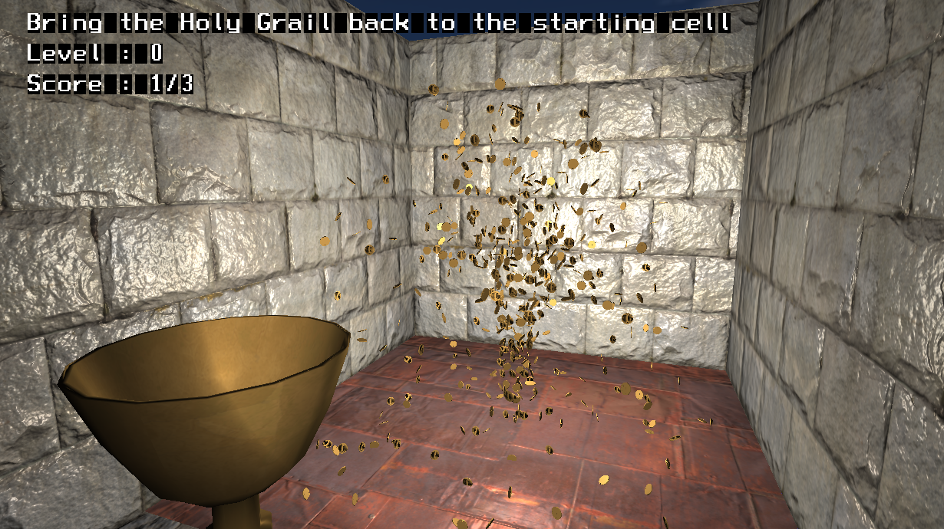
What was implemented ?
Skybox
Textured objects
Collision with walls
Ability to interact with some objects
Lightning
Score objects
Dynamic maze
Multi-level management with maze generator
Special graphics for the goal
User interface
Sound effects
Drawing optimisation
Notes:
Felix - What was implemented
Skybox
Textured objects
Collision with walls
Ability to interact with some objects
Lightning
Score objects
CLICK Dynamic maze
Multi-level management with maze generator
CLICK Special graphics for the goal
User interface
Sound effects
Drawing optimisation

Slide 5
Gameplay Demo
Notes:
Felix - Gameplay Demo
Ctrl + Alt + Right arrow to move to the game
“Make” to run
Grab score object
Show close door
Go to the key, show that one door opens but the other one closes
Grab Holy grail
Go back to start
End level
Mention sound effect and UI
CTrl + Alt + Left to go back to presentation

Slide 6
Technical details
Collisions detection
Particles system
Drawing optimisation
Lightning
Level generation
Focus on some interesting implementation details
Notes:
Felix - Technical details
Collisions detection
Player with wall
Holy grail with wall
Particles system
Drawing optimisation
Variant of frustum culling
Flood algorithm inside the maze
Lightning
Attenuation
Spotlight
Normal mapping
Level generation

Slide 7
Collision detection
Happens during the camera update
For each side of a cell, if there is a wall
Check the distance to the wall
If smaller than threshold, restore the previous value of the coordinate too close
For each corner of a cell
Check to distance to 2 walls
If smaller than threshold, find the correct coordinate to restore
Same algorithm applied to the Holy Grail
Notes:
Felix - Collision Detection
Happens during the camera update
For each side of a cell, if there is a wall
Check the distance to the wall
If smaller than threshold, restore the previous value of the coordinate too close
For each corner of a cell
Check to distance to 2 walls
If smaller than threshold, find the correct coordinate to restore
Same algorithm applied to the Holy Grail
IN GAME DEMO, try to collide player and cup with walls, DON’T end level

Slide 8
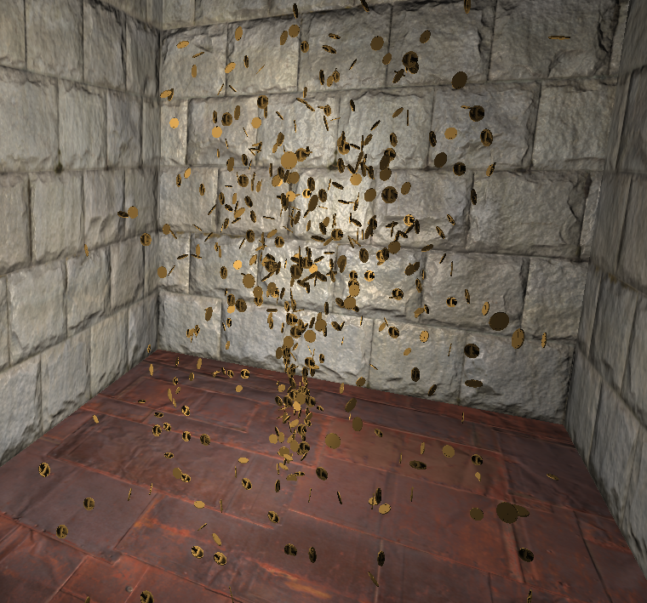
Particles system
1000 particles
Creation
Each one has original position, speed and angle
Appear under the ground, each at a different depth
Simulation
When under the ground, simply move up without gravity
Once above the ground :
Decrease vertical speed to simulate gravity
Add speed to each particle’s position + random noise
When close to the ground, decrease vertical speed
When under the ground again, reset
Notes:
Loïs - Particle System
Special graphics for the goal
1000 particles
Could probably add more, but this is the best looking
Creation
Each one has original position, speed and angle
Appears under the ground, each at a different depth
That way we can spawn them all at the same time but still have them shown at a different time
Of course not drawn if under ground
Simulation
When under the ground, simply move up without gravity -> Don’t move horizontaly so they still appear in the center of the cell, no gravity to keep momentum
Once above the ground :
Decrease vertical speed to simulate gravity (by a constant)
Add speed to each particle’s position + random noise -> make it look more natural if randomness
When close to the ground, decrease vertical speed -> when it touches to ground, it look like the particle stop falling, stay on the ground for a while
When under the ground again, reset
IN GAME DEMO, show “bouncing” on the floor, end level

Slide 9
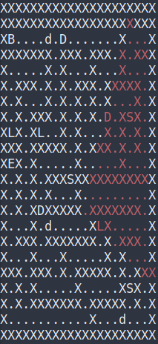
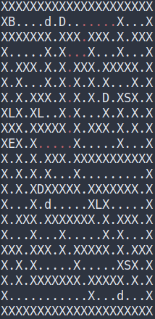
Drawing Optimisation
Frustum culling on a 2D grid
Find Triangle corners : move forward then at 90°
Use Bresenham’s line drawing algorithm
FIll using flood
Check accessible cells
Flood inside the maze up to a max distance, stop on walls and doors
Only flood by one cell backwards
Never flood in a direction opposite to a previously taken direction
Notes:
Loïs - Drawing optimisation
CLICK Frustum culling on a 2D grid
Draw on whiteboard
Find Triangle corners : move forward then at 90° on the left and right by the same distance. Will create a cone at 90°
Use Bresenham’s line drawing algorithm
FIll using flood, recursive
CLICK Check accessible cells
Draw on whiteboard
Flood inside the maze up to a max distance, stop on walls and doors
Only flood by one cell backward
Never flood in a direction opposite to a previously taken direction
IN GAME DEMO : ‘v’ in terminal to change output, ‘q’ in game

Slide 10
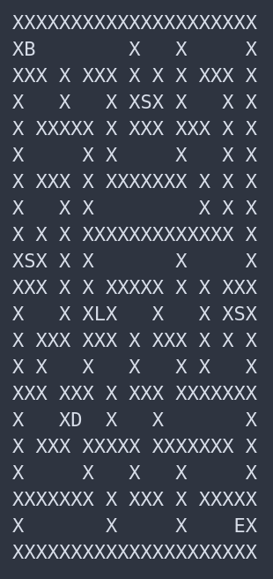
Level generation
Maze
Depth-First algorithm
End point
Flood from start by keeping track of the flood depth
Cell with max depth is the end cell
Door
Solve using depth-first search, save the path
Find the middle of the path, put door
Door switch
Flood from the cell before the door, until furthest point
If the furthest is the start cell, regenerate new maze
Score objects
Random position in maze, repeat while not great position
Notes:
Loïs - Level Generation
Maze
Depth-First algorithm
Found online : start with full grid, go randomly in a direction, if only walls -> dig inside it by 2
End point
We want to fInd the furthest cell from the start to maximize the time to solve
Recursive flood, keep track of the current depth. Not the most optimal but since small maze not a problem.
Cell with the max depth is the furthest away
CLICK Door
Solve using depth-first algorithm, save the path
While there are some cells we haven’t explored, explore it. If stuck, go back
CLICK We can count the length of solved path, then go though it again to find the middle cell
CLICK Door switch
Flood from the cell before the door, until furthest point
Sometimes, the furthest is the start cell. In this case, regenerate new maze
Score objects
CLICK Random position in maze, repeat while not in an emtpy cell and not in a dead-end. Do it 3 times
IN GAME DEMO, generate multiples mazes with ‘p’

Slide 11
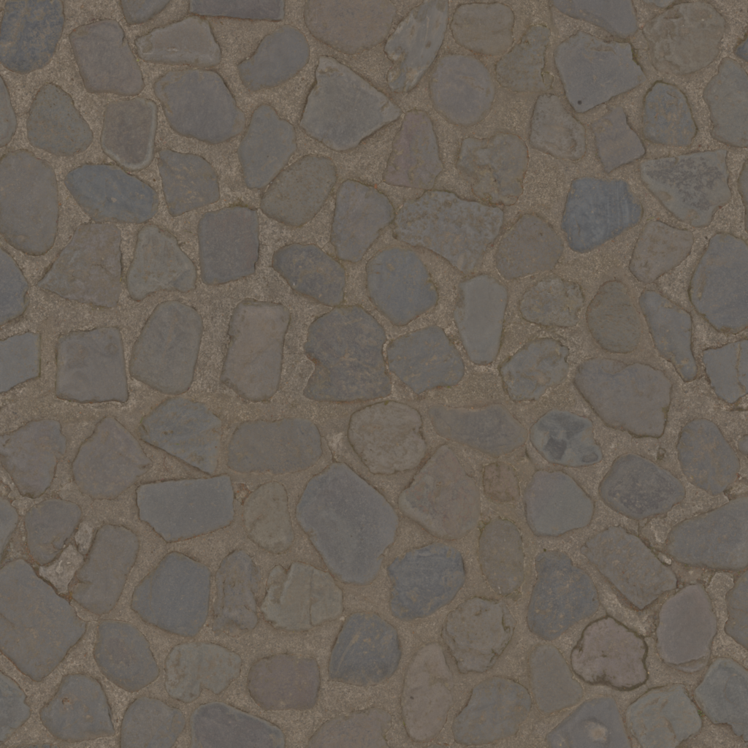
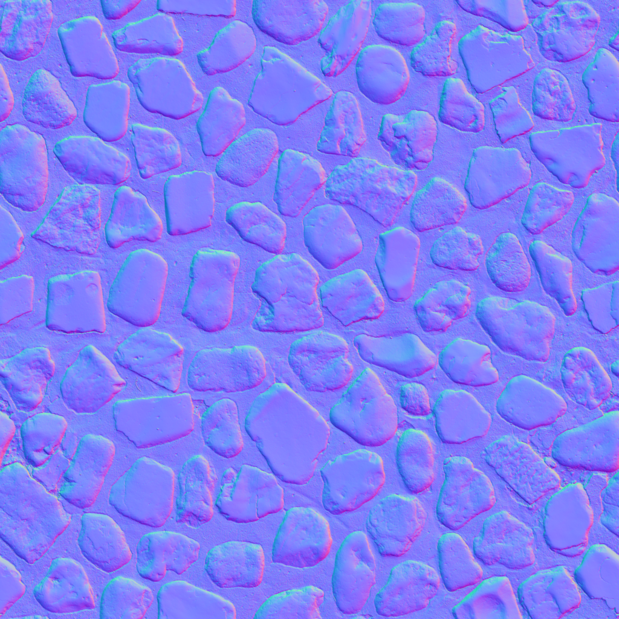
Lightning
Ambient, Diffuse and Specular lightning
Phong Shading
Attenuation
Multiply light intensity with value that decreases with the distance
Spotlight effect for moving light
Check angle between camera orientation and pixel to camera. Above 25°, attenuate
Normal mapping
Texture file contains normal vector values for each pixel
Use this instead of interpolated normal vector value
Notes:
Loïs - Lightning
Ambient, Diffuse and Specular lightning
What we did in the labs
Phong Shading
Compute value for all points, not only vertices.
Attenuation
With this, it makes everything darker, so that we don’t see a bright wall at the other end of the maze
Value that decrease with the distance multiplied with light value
Spotlight effect for moving light
Give the round effect to simulate a flashlight
Check angle between camera orientation and pixel to camera. If above threshold, attenuate
CLICK Normal mapping
Each texture has albedo and normal
Texture file contains normal vector values for each pixel
Use this instead of interpolated normal vector value
IN GAME DEMO, Disable normal with ‘n’

Slide 12
Conclusion
Takes long time to start with OpenGL
Easier to add elements afterwards
Libraries are really useful
Simple drawing optimization easily implemented, more precise one takes more time
Important to think about source code organization from the beginning
Hard to find good models / texture pairs compatible with loadtga/loadmodel
Very fun project
Notes:
Loïs - Conclusion
Takes long time to start with OpenGL
Easier to add elements afterwards
Libraries are really useful
Simple drawing optimization easily implemented, more precise one takes more time
Important to think about source code organization from the beginning
Hard to find good models / texture pairs compatible with loadtga/loadmodel, should have spend more time trying to fix this
CLICK
Very fun project

Slide 13
Ressources
Textures : www.textures.com
Models : www.turbosquid.com, www.cgtrader.com, www.free3d.com
Sounds : www.freesound.org
Code : www.github.com/joewing/maze (maze generator), www.en.wikipedia.org/wiki/Bresenham%27s_line_algorithm (line drawing for frustum culling)
Libraries : http://computer-graphics.se/TSBK07/ (CallMeAL, simplefont)
Polygons Feel No Pain, Ignemar Ragnemalm
Notes:
Loïs - Ressources
Textures : www.textures.com
Models : www.turbosquid.com, www.cgtrader.com, www.free3d.com
Sounds : www.freesound.org
Code : www.github.com/joewing/maze (maze generator), www.en.wikipedia.org/wiki/Bresenham%27s_line_algorithm (line drawing for frustum culling)
Libraries : http://computer-graphics.se/TSBK07/ (CallMeAL, simplefont)
Polygons Feel No Pain, Ignemar Ragnemalm

Slide 14
Thanks for your attention
Questions ?
Notes:
Loïs - End
Tank you for your attention
Questions ?

